Slide 1




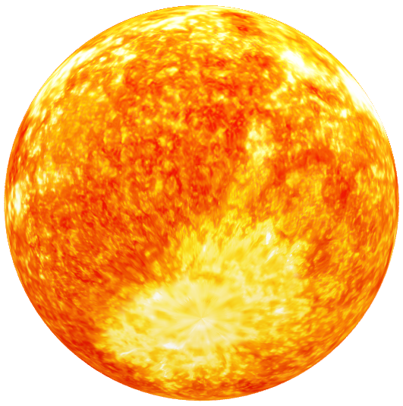
Prevention of sun ultraviolets: risk map
ArcGis project Paul Claviere-Schiele and Teng Lucia
Notes:
L

Slide 2

Table of content 1) Objective of the study 2) Data 3) Methods 4) Results 5) Issue 6) To continue
Notes:
L

Slide 3
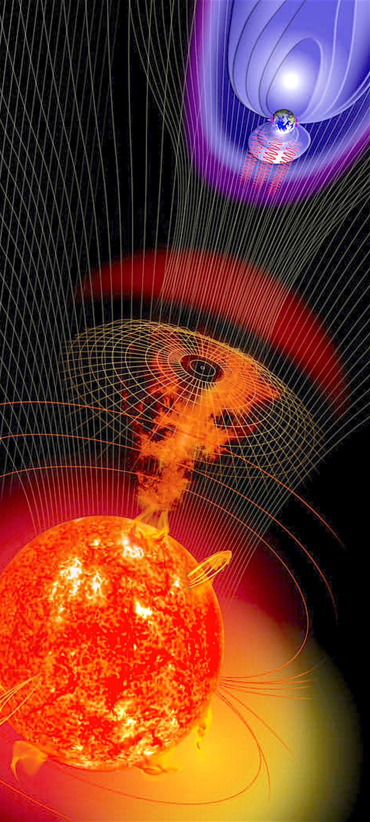
1) Objective of the project
Solar flare : huge explosion of radiation, release of magnetic energy.
This project is aimed to find vulnerable zones on the globe in the case of big solar flares. It takes as input
date and data Solar’s angle, Population grid and the pollution with the PM2.5 and the output is the areas with risks.
Notes:
L

Slide 4
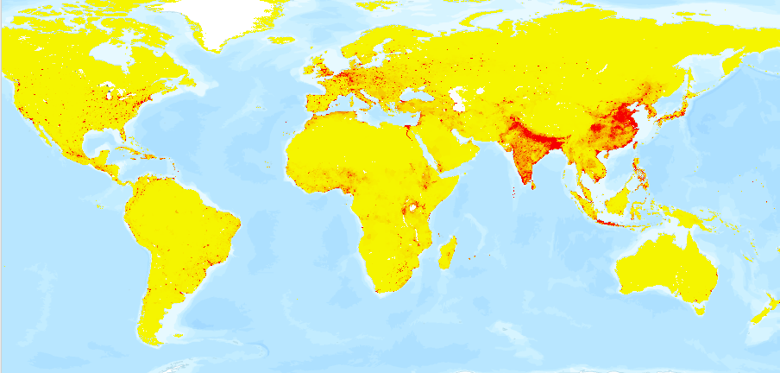
2) Data export
Population grid Data
Notes:
P

Slide 5
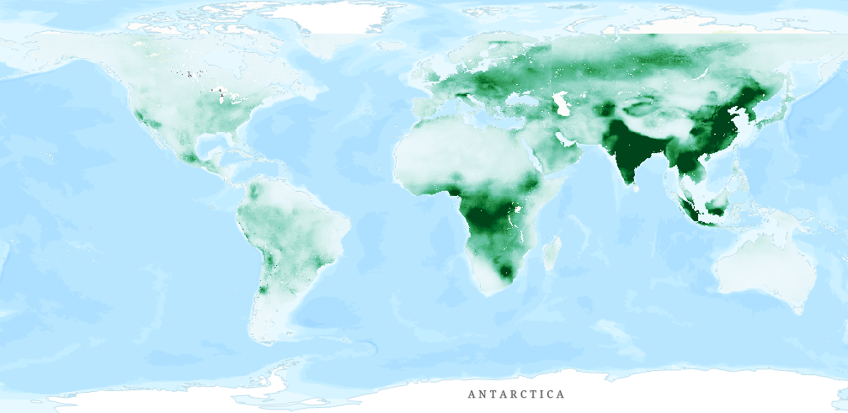
2) Data export
PM2.5 Data
Notes:
P

Slide 6
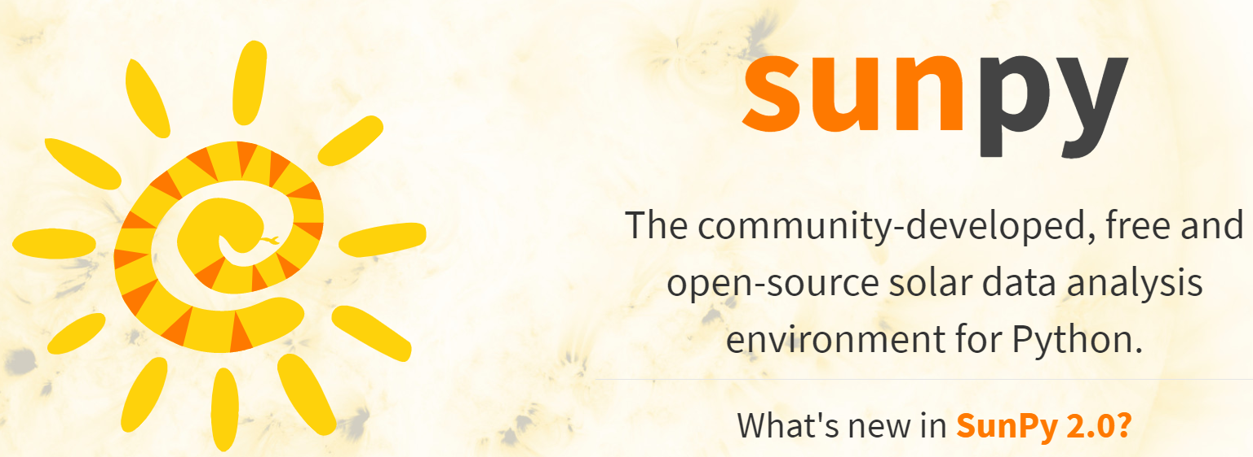
2) Data export
Sun angle
Notes:
P

Slide 7
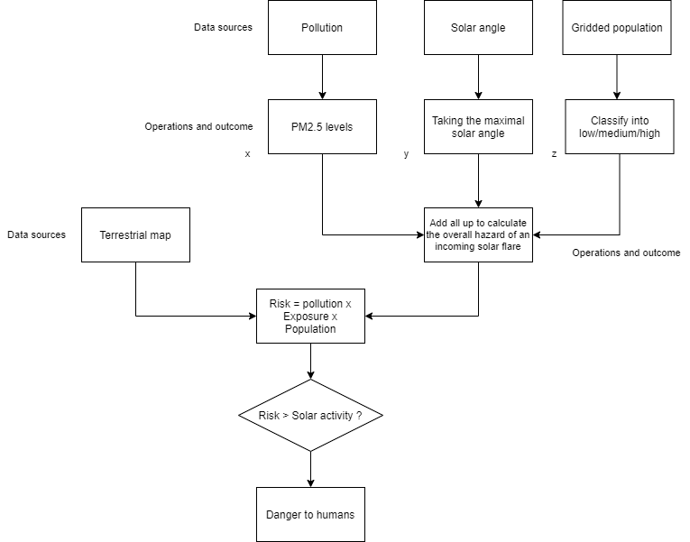
3) Methods
Flowchart of the risk map project
Notes:
L

Slide 8
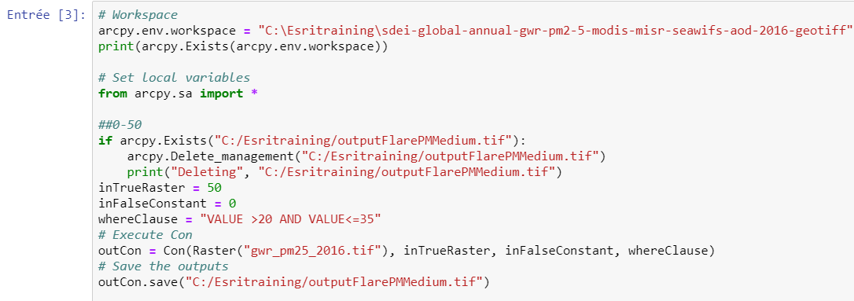
3) Methods : Data selection for the pollution (PM2.5)
Notes:
L

Slide 9
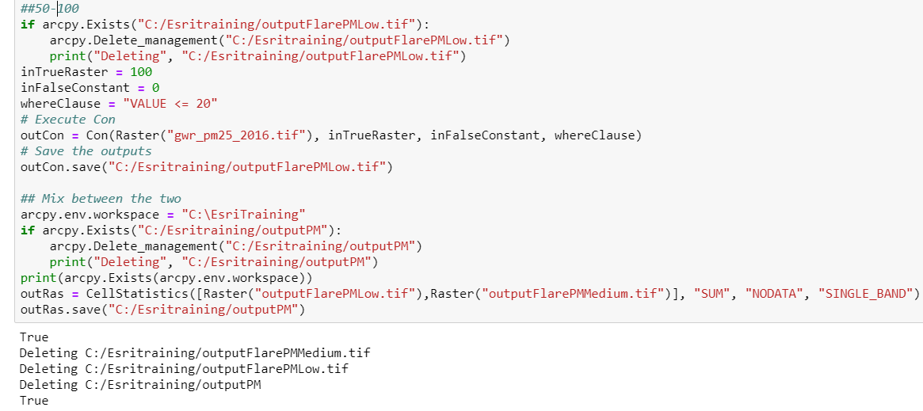
3) Methods : Data selection for the pollution (PM2.5)
Notes:
L

Slide 10
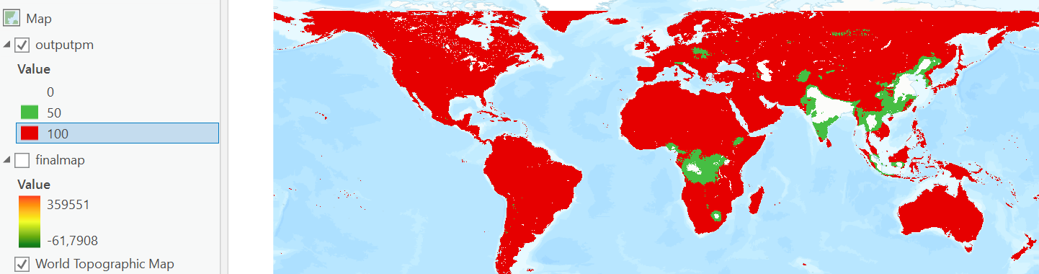
3) Methods : Data selection for the pollution (PM2.5)
Notes:
L

Slide 11
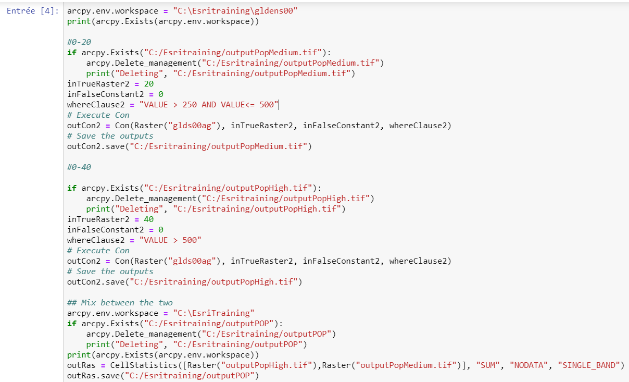
3) Methods : Data selection for the population
Notes:
P

Slide 12
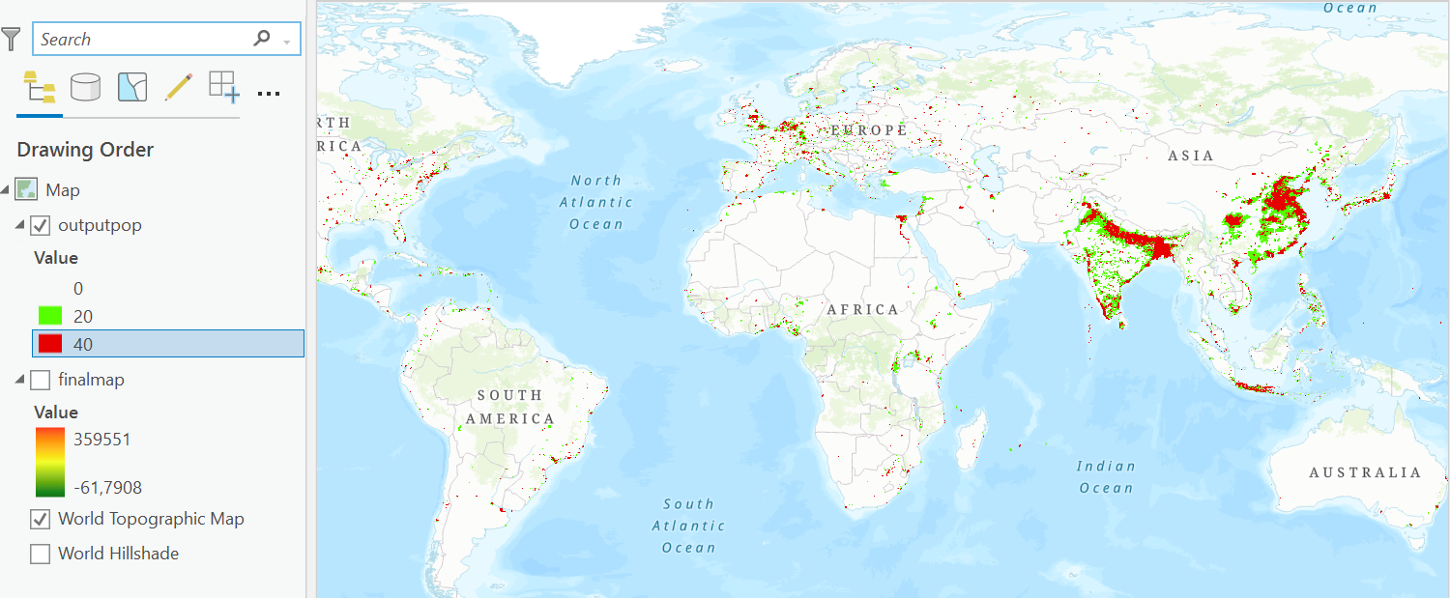
3) Methods : Data selection for the population
Notes:
P

Slide 13
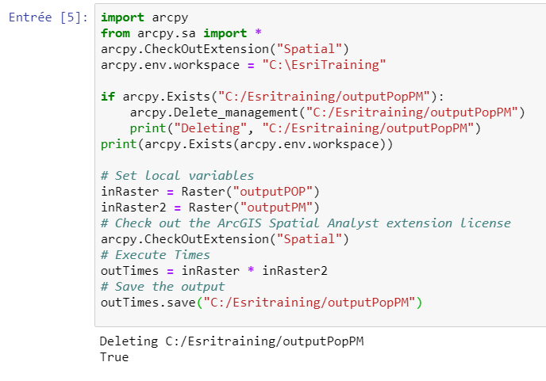
3) Methods : Intersection between PM2.5 and population grid
Notes:
P

Slide 14
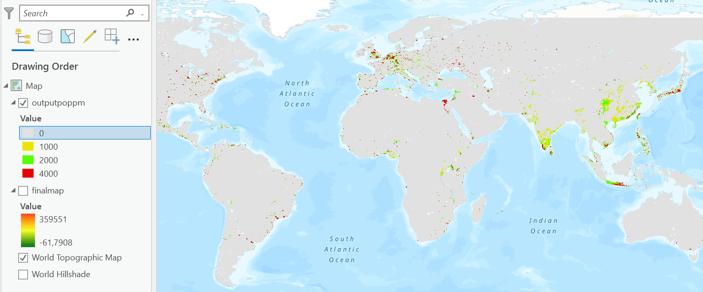
3) Methods : Intersection between PM2.5 and population grid
Notes:
P

Slide 15
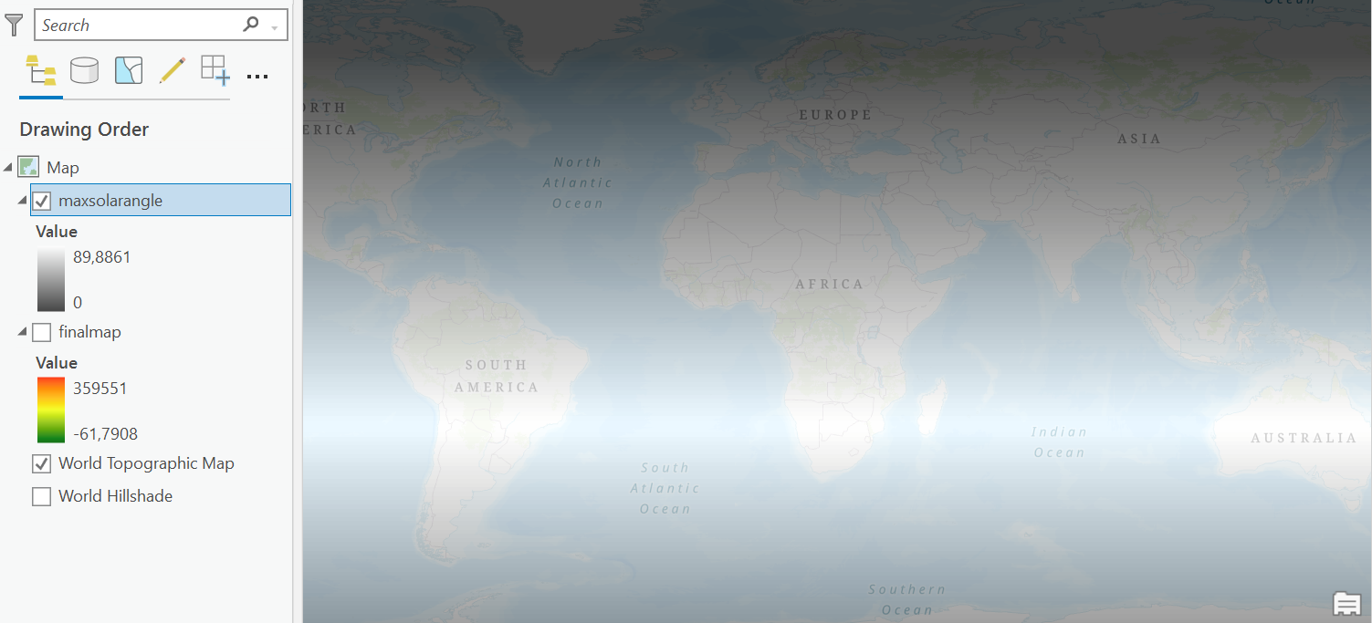
3) Methods : Maximal solar angle
Notes:
L

Slide 16
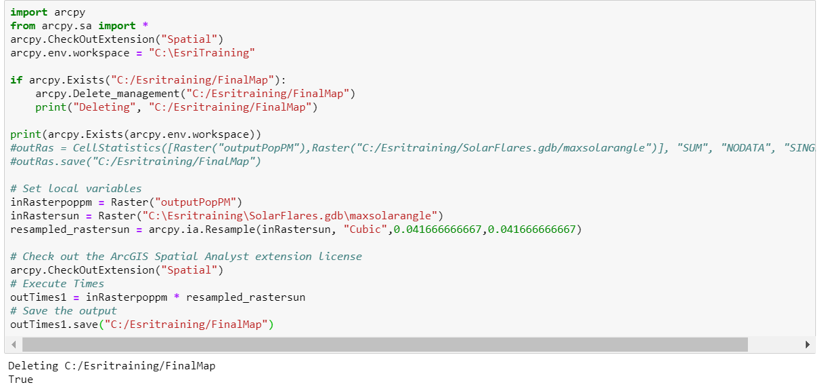
3) Methods : Link between sun angle, pollution, and population
Notes:
L

Slide 17
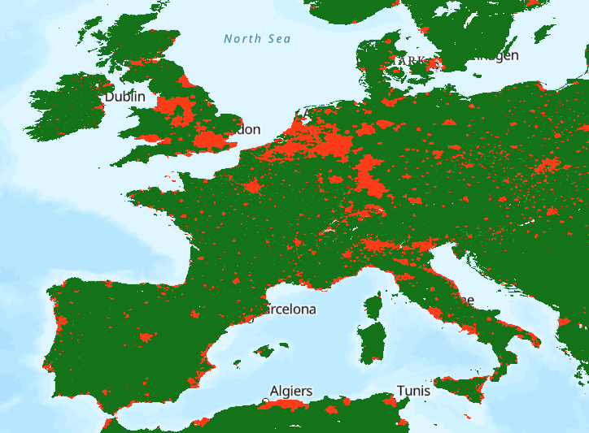
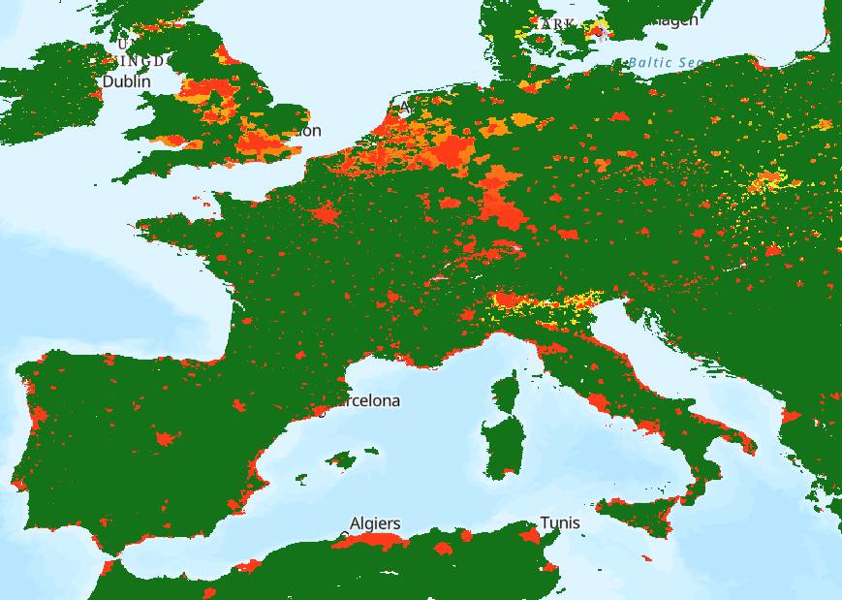
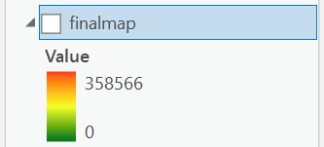
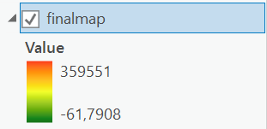
4) Results
Notes:
P

Slide 18
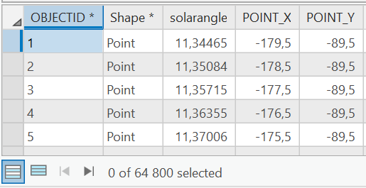

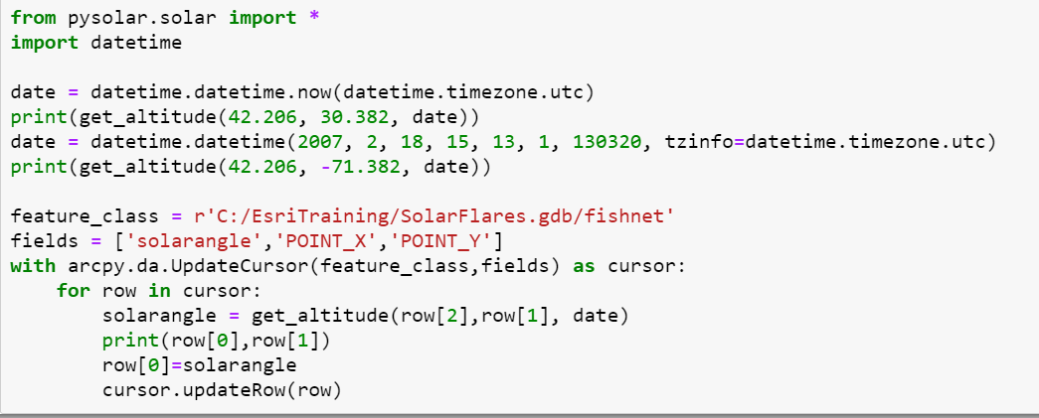
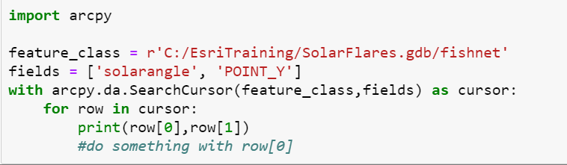
5) Issue : Sun’s angle
Notes:
P

Slide 19
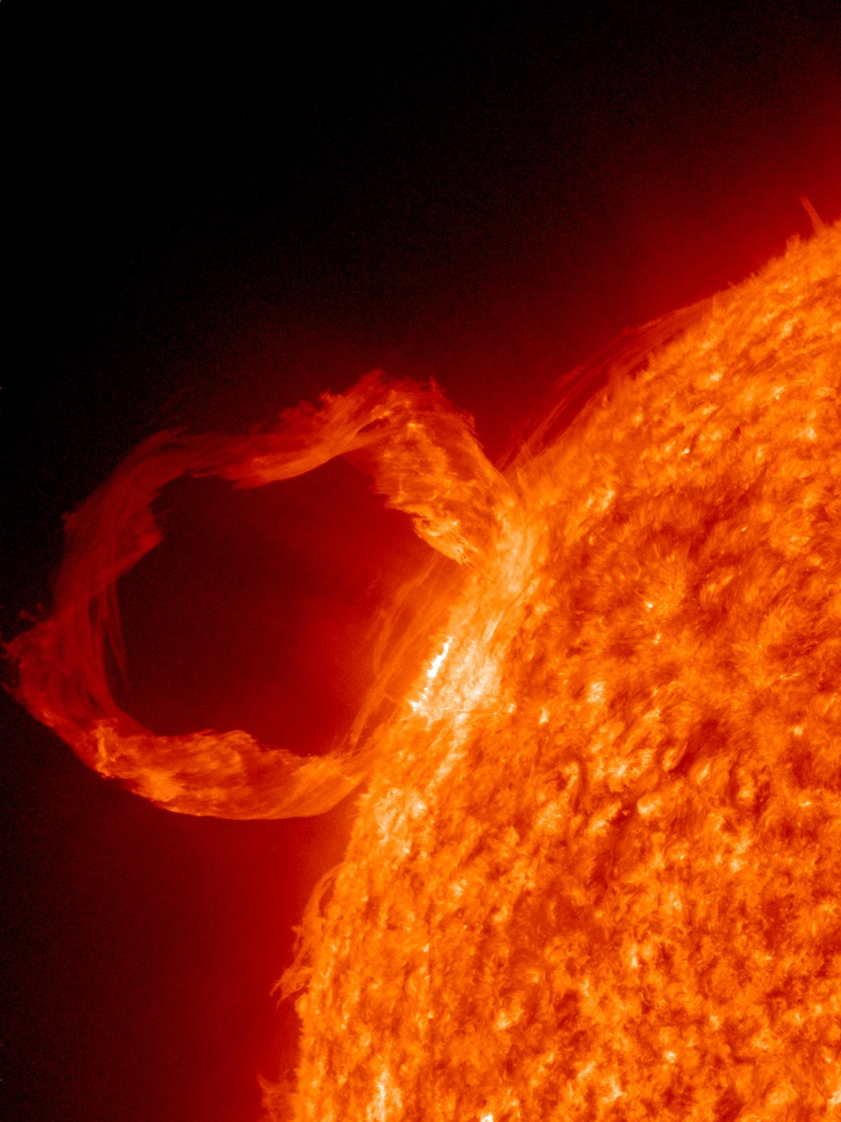
6) Conclusion on Arcpy
Change parameters is easier
Do computation on Python was clearer
Convenient when using a lot of rasters
Notes:
L

Slide 20
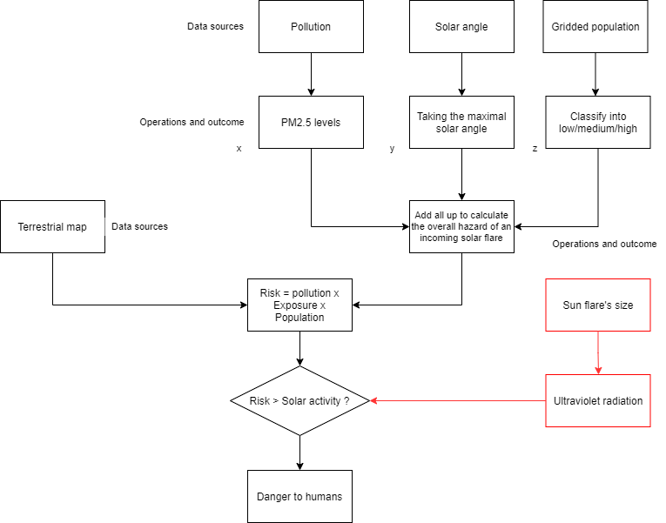
6) To do next
Flowchart of the future risk map project
Notes:
L

Slide 21
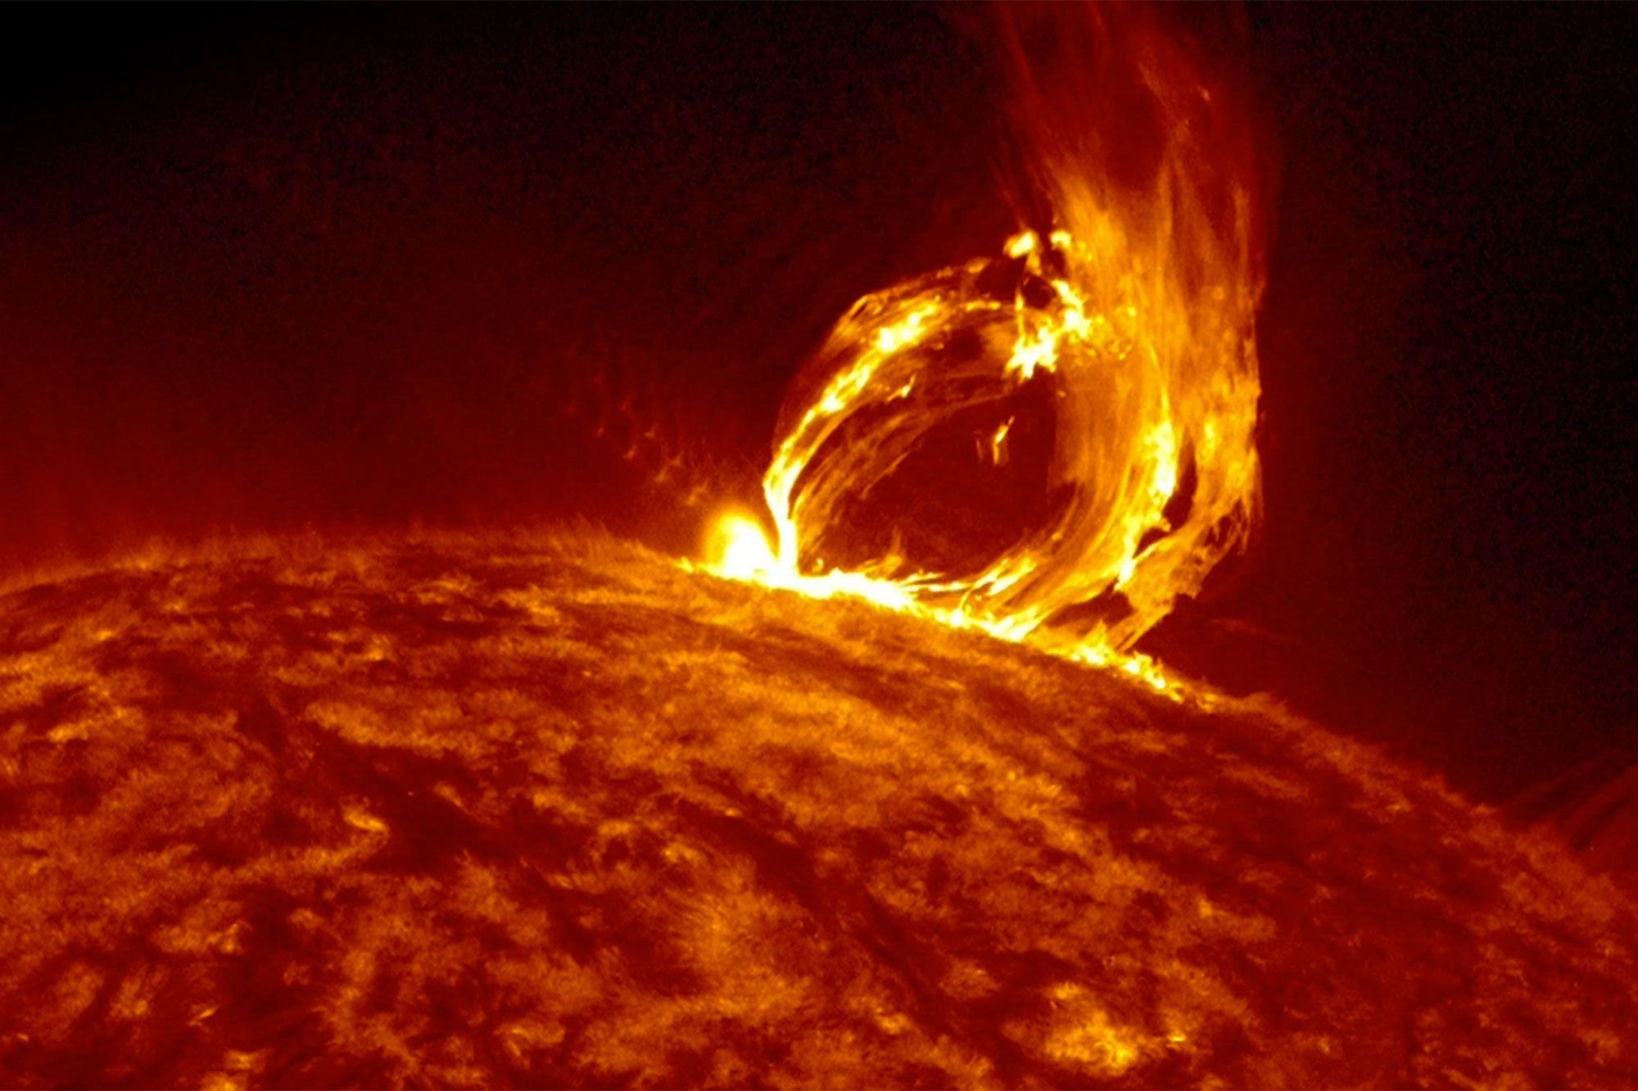
Thank you for your attention Any questions?
Notes:
P & L

